Slide 1
NOSOUNDALOUD
PITCH
#CRITICALSoftware
#SummerWeekCRITICAL

Slide 2


NOSOUNDALOUD
A team-shared workplace can often be an hostile environment to work in. Specially when there are no rules that guarantee the harmony needed between teams so every group gets the best working conditions
The Problem
Team communication is key in any job to produce the best results possible.

Slide 3
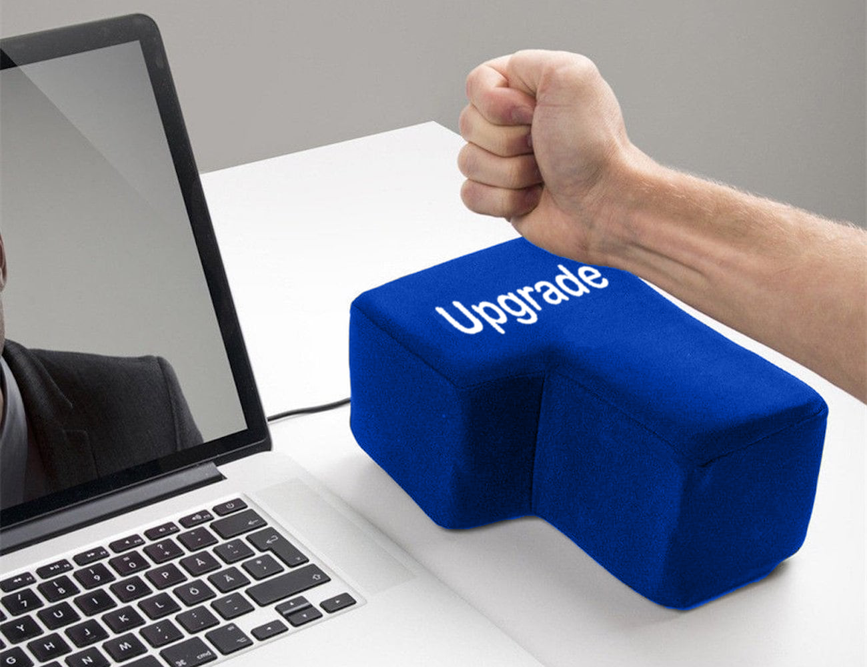

Slide 4




We Propose…
An IoT Solution
Insert Product Picture here
Noise & Temperature Levels Detector
Glowing Protective Shell
Monitored Info.

Slide 5

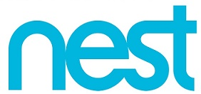



Who Wants Our Product?
The market opportunity is huge. The biggest companies worldwide are investing billions of dollars in this technology.
Our Product is the perfect fit for companies who want to start to implement IoT resources in their working environment.
Notes:
Microsoft just did an investment of $5 Billion on in IoT
Samsung bought SmartThings for $200 Million
Google bought NEST for $3.2 Billion

Slide 6
Deeper Into The Technology

